Slide 1


INFLUENCES ON EVALUATION: IMPLEMENTATION SCIENCE AND ITS USEFULNESS FOR EVALUATION
Robyn Mildon, PhD
Parenting Research Centre
Annette Michaux & Andrew Anderson
The Benevolent Society annettem@bensoc.org.au

Slide 2
This session covers
What is implementation and why does it matter?
Move to, and importance of, evaluating implementation of services and programs
Evidence informed approaches to implementation
Approaches to evaluating implementation
Case study

Slide 3

Implementing Evidence-Informed Practice
World of Research
World of Practice
Adapted from Riley, 2005
3
Notes:
3
Not just in UK, we too, have to Mind the Gap…
3

Slide 4
What is implementation?
Implementation is defined as a specified set of activities designed to put into practice an activity or program of known dimensions (Fixsen et al, 2005)
Implementation is a purposeful, active process with core components
Research
Implementation
Practice
Notes:
Implementation is the constellation of processes intended to get an intervention into use within an organisation; it is the means by which an intervention is assimilated into an organisation. Implementation is the critical gateway between an organisational decision to adopt an intervention and the routine use of that intervention; the transition period during which targeted stakeholders become increasingly skilful, consistent, and committed in their use of an intervention (Damschroder et al 2009)
Implementation is defined as a specified set of activities designed to put into practice an activity or program of known dimensions. According to this definition, implementation processes are purposeful and are described in sufficient detail such that independent observers can detect the presence and strength of the "specific set of activities" related to implementation. In addition, the activity or program being implemented is described in sufficient detail so that independent observers can detect its presence and strength.
When thinking about implementation the observer must be aware of two sets of activities (intervention-level activity and implementation-level activity) and two sets of outcomes (intervention outcomes and implementation outcomes).
It is common to read about "implementation" of a program or practice as if it were an accomplished fact when the context of the statement makes it clear that some process (more or less clearly described) had been put in place to attempt the implementation of that program or practice. When faced with the realities of human services, implementation outcomes should not be assumed any more than intervention outcomes are assumed.

Slide 5
Why focus on implementation?
Many programs and practices found to be effective in child and family support research fail to translate into meaningful outcomes across a number service settings
Some research indicates that two-thirds of organisations’ efforts to implement change fail (Burns, 2004).

Slide 6
    “Evidence” on effectiveness helps you select what to implement for whom
    This “Evidence” does not help you implement the program or practice
Fixsen & Blase (2008)

Slide 7
Science to service gap
Often, what is known is not what is adopted to help children, families and caregivers.
Implementation gap
There are no clear pathways to implementation.
Often, what is adopted is not used with fidelity and good effect.
What is implemented often disappears with time and staff turnover.
(Fixsen et al, 2005)

Slide 8
Implementation Matters (from Fixsen et al., 2005)
Implementation: The How
Effective
Not Effective
Inconsistent; not sustainable; poor outcomes
Effective
Actual benefits
Intervention – The What
Poor outcomes; sometimes harmful
Not Effective
Poor outcomes
(Institute of Medicine, 2000; 2001; 2009; New Freedom Commission on Mental Health, 2003; National Commission on Excellence in Education,1983; Department of Health and Human Services, 1999)

Slide 9
Why does evaluation of implementation matter?
If programs and other services are not clearly specified and are not delivered in a way which is consistent with program and service objectives, it is likely that evaluation results will be less than useful, or, perhaps, meaningless.
Conclusions are made that a program is not effective, when the measurement may have reflected inadequate implementation of the intervention rather than an issue with the intervention itself.
Notes:
In the evaluation field there is a growing emphasis on process and implementation evaluation in addition to outcome evaluations. If interventions and other services are not clearly specified and are not delivered in a way which is consistent with program and service objectives, it is likely that evaluation results will be less than useful, or, perhaps, meaningless. This can result in a Type III error, where for example, conclusions are made that a program is not effective, when the measurement may have reflected inadequate implementation of the intervention rather than an issue with the intervention itself. Several studies have documented a relationship between levels and quality of program implementation and strength of program outcomes.

Slide 10
Implementation matters
500 studies evaluated in five meta-analyses
Indicates that the magnitude of mean effect sizes are two to three times higher when programs are carefully implemented and free from serious implementation problems than when these circumstances are not present
59 additional quantitative studies found that higher levels of implementation are associated with better outcomes, particularly when fidelity or dosage is assessed.
Durlak & DuPre (2008)
Notes:
Several studies have documented a relationship between levels and quality of program implementation and strength of program outcomes.
Joseph A. Durlak & Emily P. DuPre (2008)
conducted a review to assess the impact of implementation on program outcomes
second purpose was to identify factors affecting the implementation process.
Data from 59 additional quantitative studies confirms that higher levels of implementation are often associated with better outcomes, particularly when fidelity or dosage is assessed.
Findings from 81 additional reports indicate there are at least 23 contextual factors that influence implementation. The implementation process is affected by variables related to communities, providers and innovations, and aspects of the prevention delivery system (i.e., organizational functioning) and the prevention support system (i.e., training and technical assistance). The collection of implementation data is an essential feature of program evaluations, and more information is needed on which and how various factors influence implementation in different community settings.

Slide 11
Implementation matters
Dissemination of effective programs, which involves their adaptation to new settings, cannot be accomplished without a clear understanding of how the program accomplishes its effects.
Reinvention of a program is acceptable, but only if its’ causal mechanisms are understood and preserved. In addition, the original mission or intent of the program must also be understood and preserved.
Notes:
In addition to the potential for Type III errors, the dissemination of effective programs, which involves their adaptation to new settings, cannot be accomplished without a clear understanding of how the program accomplishes its effects. Reinvention of a program is acceptable, but only if its’ causal mechanisms are understood and preserved. In addition, the original mission or intent of the program must also be understood and preserved. Complex community and school-based programs are particularly susceptible to Type III errors because they are composed of multiple components and thus there are multiple potential causal elements whose contributions to outcome may not be known.

Slide 12
Including evaluation of implementation
Necessary to gain insight into the “black box” of interventions.
Process evaluations including information about program implementation is needed to evaluate services and the programs they offer
A study of program implementation process could improve the validity of findings and help to explain why a program succeeded or failed
Notes:
As a result, it has been recognized that aside from outcome evaluations, it is necessary to gain insight into the ‘black box’ of interventions. It has been suggested that a process evaluation including information about program implementation is needed to evaluate services and the programs they offer. A study of program implementation process could improve the validity of the findings and help to explain for what specific reasons an service and program succeeded or failed

Slide 13
To implement evidence-based practices and programs we need...
The What:
What is the program/practice
The How:
Effective implementation frameworks (e.g. strategies to change and maintain behaviour of practitioners and create hospitable organisational systems)
The Who:
Expert implementation assistance

Slide 14
Evidence-based practice and programs
Evidence-based practices
skills, techniques, and strategies that can be used by a practitioner.
common elements (Chorpita et al) / kernels (Embry, 2004)
Evidence-based programs
collections of practices that are done within known parameters (philosophy, values, service delivery structure, and treatment components)

Slide 15
Evidence informed implementation:
Implementation frameworks
The value of frameworks is
To promote the ability to generalise beyond the immediate project or initiative
To enhance communication among partners (e.g. better understanding of one another)
To more easily share and apply improvements
To increase the relevance of the “lessons learned”

Slide 16
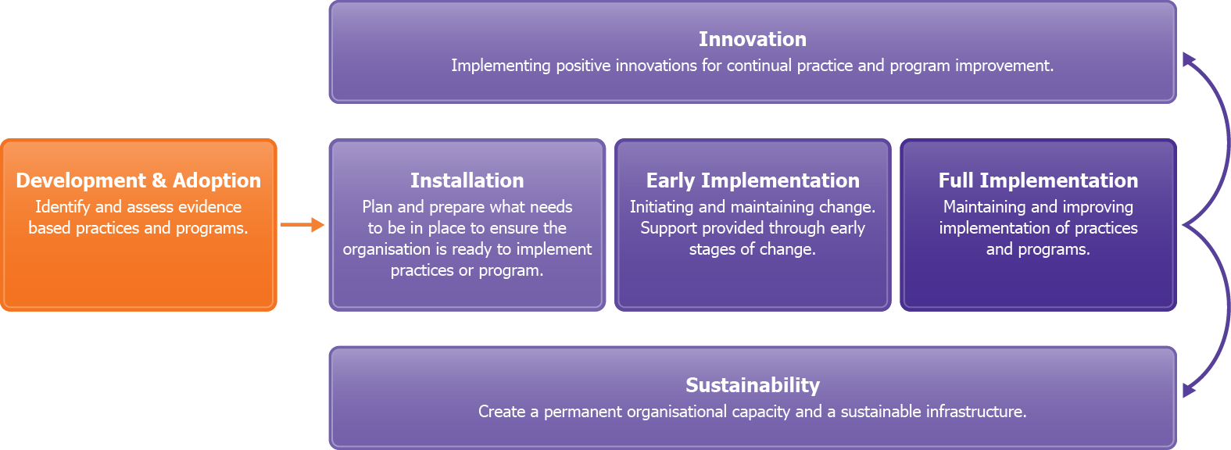
Evidence informed approaches to implementation
PRC Knowledge to Implementation Cycle
(based on Fixsen et al 2005 & Aarons et al, 2011)

Slide 17
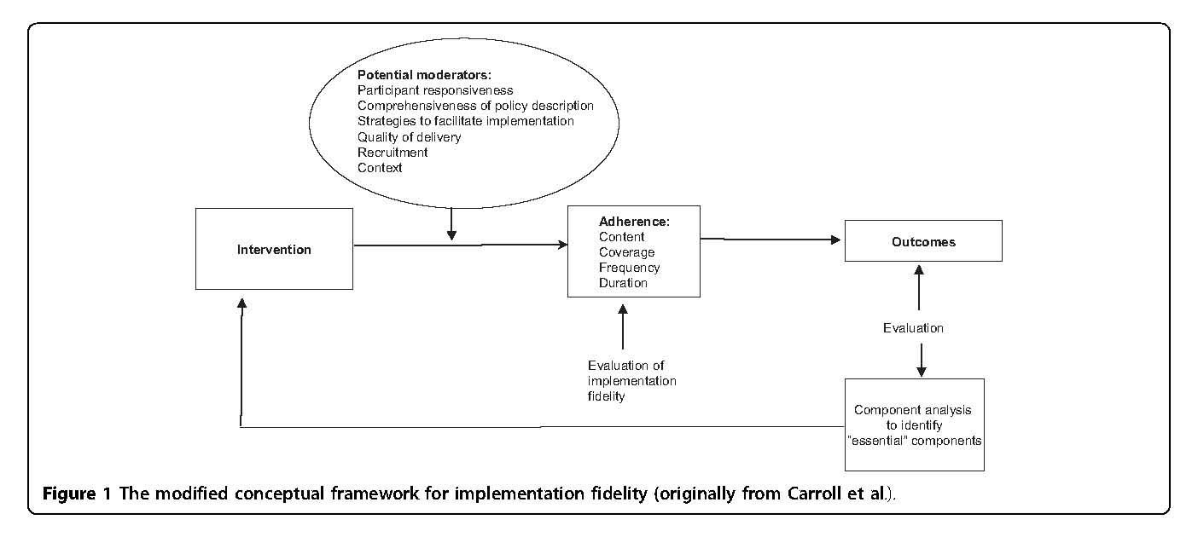
Notes:
Model for implementation evaluations – looking at implementation and program outcomes

Slide 18
Agency Level
The ‘what’ is in further development
Refinement of an agency wide practice framework aimed at promoting the resilience in vulnerable children and their families

Slide 19
Case study
Consultation phase, where is the agency at?
Exploration? Assess readiness and fit, ensure platform built through implementation teams (planning)
Installation? Are the resources which are necessary to start project ready and available (installing)
Initial Implementation? frequent problem-solving at the practice and program levels. (supporting)
Full Implementation? Assure components are integrated into the organization and are functioning effectively to achieve desired outcomes.
(improving and sustaining)

Slide 20
Exploration – Resilience Practice Framework
Past implementation failure – demonstrated by previous research
NEW APPROACH – phase 1 exploration
Learning circles to raise awareness
Phase 1 evaluation – usefulness of learning circles

Slide 21
Project Scale
21
Who does it involve :
350 Child and Family staff
5 large geographic areas (60 sites in two states in Metropolitan, Regional & Rural contexts)
Across program types

Slide 22
Project Governance
Operations
Group
The Way Forward:
Child & Family
Parenting Research Centre
Practice Imp. Team
AIFS
UNI SA
EIP Learning Circle Leaders
Metro
Central
SW & W
R&R NSW
QLD
22

Slide 23
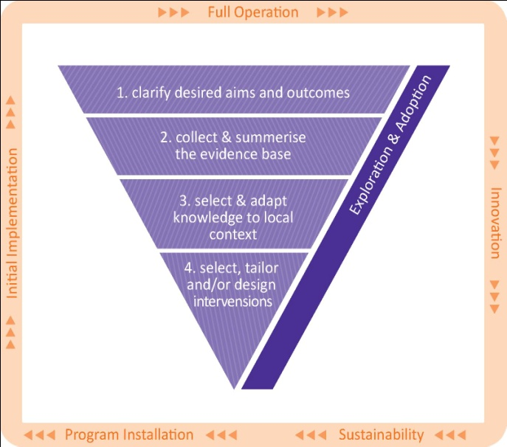
Knowledge to Implementation cycle
Notes:
The Knowledge to Implementation cycle allows for:
full consideration and inclusion of the evidence and knowledge from both research and practice
a contextual and flexible approach to intervention selection, or intervention development, service design and implementation
a two-way exchange of knowledge between researchers, program developers, managers and practitioners
the provision of purposeful and active support for the implementation of evidence-informed practices that draws from the most effective approaches to implementation

Slide 24
Initial installation
5 resilience outcomes agreed (previously about 40 outcomes)
Resilience measures agreed
5 evidence informed practice guides
Implementation of practice guides
Developing evidence based kernels for practice and behaviour change

Slide 25
Evaluation of the framework (the what)
Evaluate new practice – are the 5 outcomes changing for children and parents?
Framework for evaluating implementation of the resilience practices – re-survey staff about their ability to implement resilience

Slide 26
Learning to implement better
Back to planning – did the training & learning circles BUT…implementation is so much more
Needed more supervision to embed practice
Supervisors – central to the process – need lots of direction with new practices
Supervision skills for the managers – coaching
External experts

Slide 27
Next steps
How are we going with the How: Evaluating implementation……
We have been struggling…

Slide 28
Why this has been hard?
  Priority is program evaluation rather than implementation evaluation
competing demands
less investment in implementation evaluation
time in planning v pressure to execute
lack of sophistication in some org systems

Slide 29
Celebrate what we are getting right - implementation
  highly planned… more than ever before
  not cracked it but better than we were
  now have one language of practice
  technical assistance

Slide 30


